Slide 1

Fundamentals of Web Development
Third Edition by Randy Connolly and Ricardo Hoar
Chapter 4
(In the book this is chapters 8,9 and 10)
JavaScript Part1:
Language Fundamentals
Copyright © 2021, 2018, 2015 Pearson Education, Inc. All Rights Reserved

Slide 2
In this chapter you will learn . . .
About JavaScript’s role in contemporary web development
How to add JavaScript code to your web pages
The main programming constructs of the language
The importance of objects and arrays in JavaScript
How to use functions in JavaScript

Slide 3
What Is JavaScript and What Can It Do?
JavaScript: it is an object-oriented scripting language ( interpreted )
primarily a client-side scripting language.
variables are objects in that they have properties and methods
Unlike more familiar object-oriented languages Such as Java, C#, and C++, functions in JavaScript are also objects.
JavaScript is dynamically typed (also called weakly typed) in that variables can be easily (or implicitly) converted from one data type to another.

Slide 4
Client-Side Scripting: Advantages
Processing can be off-loaded from the server to client machines, thereby reducing the load on the server.
The browser can respond more rapidly to user events than a request to a remote server ever could, which improves the user experience.
JavaScript can interact with the downloaded HTML in a way that the server cannot, creating a user experience more like desktop software than simple HTML ever could.

Slide 5
Client-Side Scripting: Disadvantages
There is no guarantee that the client has JavaScript enabled, meaning any required functionality must be implemented redundantly on the server.
JavaScript-heavy web applications can be complicated to debug and maintain.
JavaScript is not fault tolerant. Browsers are able to handle invalid HTML or CSS. But if your page has invalid JavaScript, it will simply stop execution at the invalid line.
While JavaScript is universally supported in all contemporary browsers, the language (and its APIs) is continually being expanded. As such, newer features of the language may not be supported in all browsers.

Slide 6
JavaScript’s History
JavaScript was introduced by Netscape in their Navigator browser back in 1996.
Netscape submitted JavaScript to ECMA International in 1997, ECMAScript is the official specification of the JavaScript programming language.
The Sixth Edition (or ES6) was the one that introduced many notable new additions to the language (such as classes, iterators, arrow functions, and promises)
The latest version of ECMAScript is the 14th Edition (generally referred to as ES14 or ES2023)
Notes:
ECMA: European Computer Manufacturers Association

Slide 7
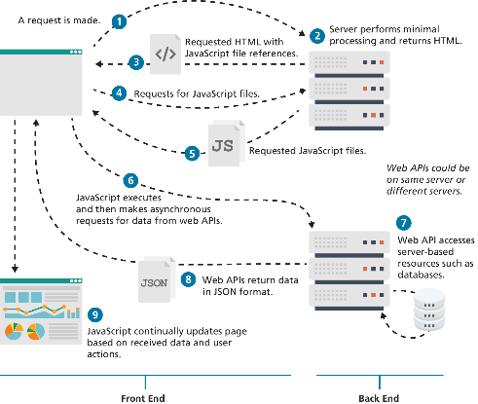
JavaScript and Web 2.0

Slide 8
Where Does JavaScript Go?
Just as CSS styles can be inline, embedded, or external, JavaScript can be included in a number of ways.
Inline JavaScript refers to the practice of including JavaScript code directly within some HTML element attributes.
Embedded JavaScript refers to the practice of placing JavaScript code within a <script> element in the HTML document
The recommended way to use JavaScript is to place it in an external file. You do this via the <script> tag

Slide 9
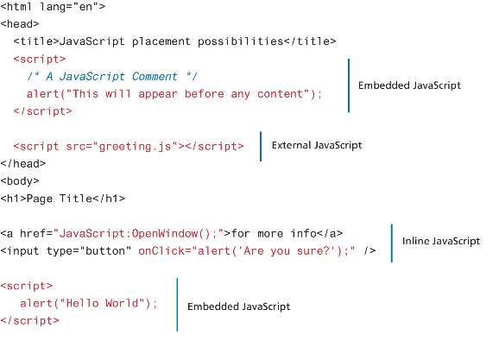
Adding JavaScript to a page

Slide 10
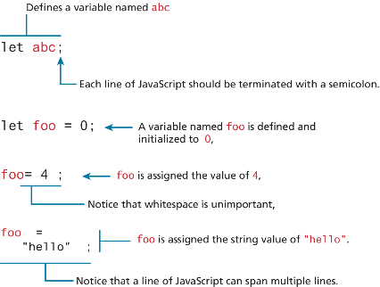
Variables and Data Types
Variables in JavaScript are dynamically typed, meaning that you do not have to declare the type of a variable before you use it.
To declare a variable in JavaScript, use either the var, const, or let keywords.
Note: When you copy/paste code in Javascript, the quotes can be altered to non-valid quotes, so always verify that you have the correct quotes ( ‘, “) after a copy/paste.

Slide 11
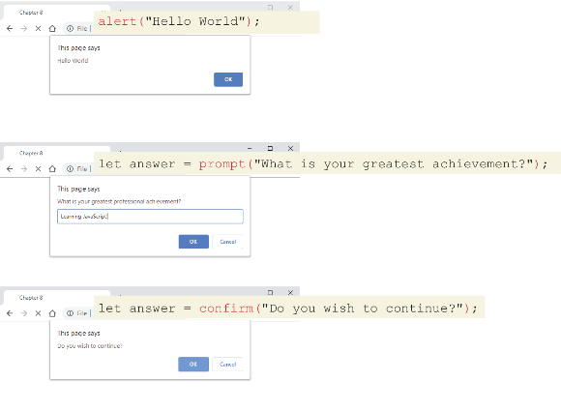
JavaScript Output
alert() Displays content within a browser-controlled pop-up/modal window.
prompt() Displays a message and an input field within a modal window.
confirm() Displays a question in a modal window with ok and cancel buttons.
let answer = prompt("Please enter your name:");
alert('your name is ' + answer);

Slide 12
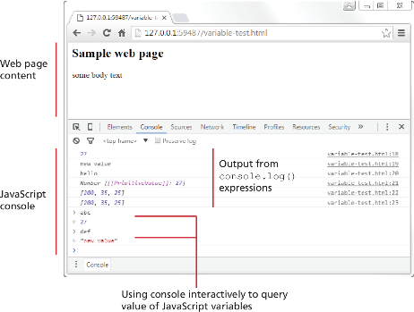
JavaScript Output (ii)
document.write() Outputs the content (as markup) directly to the HTML document.
let answer = prompt("Please enter your name:");
document.write('<h1>your name is ' + answer + '</h1>');
console.log() Displays content in the browser’s JavaScript console.
Notes:
Read about sanitizing HTML to prevent XSS attacks: https://github.com/cure53/DOMPurify

Slide 13
Data Types
JavaScript has two basic data types:
reference types (usually referred to as objects)
primitive types (i.e., non-object, simple types).
What makes things a bit confusing for new JavaScript developers is that the language lets you use primitive types as if they are objects.

Slide 14
Primitive Types
boolean True or false value.
number Represents some type of number. Its internal format is a double precision 64-bit floating point value.
bigint Represents an integer that can be very large (> 2⁵³)
string Represents a sequence of characters delimited by either the single or double quote characters.
null Has only one value: null.
undefined Has only one value: undefined. This value is assigned to variables that are not initialized. Notice that undefined is different from null.
symbol Is a key that is guaranteed to be unique created for a given value Symbol.for(“Selem”)

Slide 15
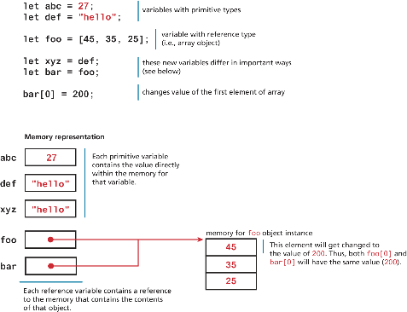
Primitive vs Reference Types
Primitive variables contain the value of the primitive directly within memory.
In contrast, object variables contain a reference or pointer to the block of memory associated with the content of the object.

Slide 16
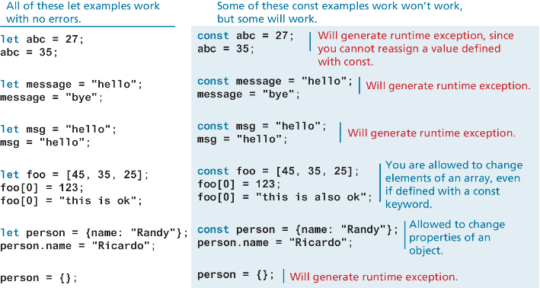
Let vs const

Slide 17
Built-In Objects
JavaScript has a variety of objects you can use at any time, such as arrays, functions, and the built-in objects.
Some of the most commonly used built-in objects include Object, Function, Boolean, Error, Number, Math, Date, String, and Regexp.
Later we will also frequently make use of several vital objects that are not part of the language but are part of the browser environment. These include the document, console, and window objects.
let def = new Date();
// sets the value of abc to a string containing the current date
let abc = def.toString();

Slide 18
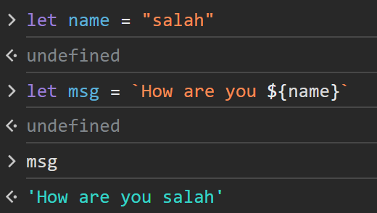
Concatenation
To combine string literals together with other variables. Use the concatenate operator (+).
Or use template strings:
const country = "France";
const city = "Paris";
const population = 67;
const count = 2;
let msg = city + " is the capital of " + country;
msg += " Population of " + country + " is " + population;
let msg2 = population + count;
// what is displayed in the console?
console.log(msg);
//Paris is the capital of France Population of France is 67
console.log(msg2);
// 69
LISTING 8.1 Using the concatenate operator

Slide 19
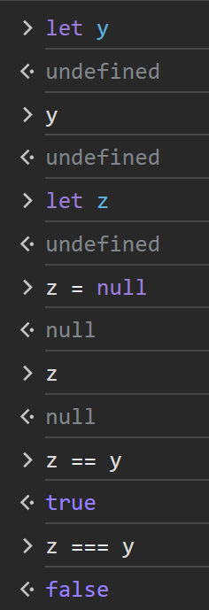
Conditionals
JavaScript’s syntax for conditional statements is almost identical to that of PHP, Java, or C++.
In this syntax the condition to test is contained within () brackets with the body contained in {} blocks. Optional else if statements can follow, with an else ending the branch.
JavaScript has all of the expected comparator operators (<, >, ==, <=, >=, !=, !==, ===).
let answer = prompt("Please enter your name:");
if(!answer) console.log('the answer is empty');
else console.log('Great: ' + answer);
Notes:
== tries to convert types before comparison so always use === as == can have strange behavior:
'' == '0' // false
0 == '' // true
0 == '0' // true
false == 'false’ // false
false == '0' // true
false == undefined // false
false == null // false
null == undefined // true
' \t\r\n ' == 0 // true

Slide 20
Switch statement
switch (artType) {
case "PT":
output = "Painting";
break;
case "SC":
output = "Sculpture";
break;
default:
output = "Other";
}
// equivalent
if (artType == "PT") {
output = "Painting";
} else if (artType == "SC") {
output = "Sculpture";
} else {
output = "Other";
}
The switch statement is similar to a series of if...else statements.
Note: Better avoid switch syntax because it can easily lead to errors.
There is another way to make use of conditionals: the conditional operator ( ? : also called the ternary operator):
let answer = prompt("Please enter your name:"); console.log( (!answer)? 'the answer is empty': 'Great: ' + answer);

Slide 21
Truthy and Falsy
Everything in JavaScript has an inherent Boolean value.
In JavaScript, a value is said to be truthy if it translates to true, while a value is said to be falsy if it translates to false.
All values in JavaScript are truthy except false, null, "", '', 0, NaN (0/0, sqrt(-1)), and undefined
Try:
let a = 2;
let b;
!!a ; // true -> truthy
!a ; // false -> falsy
!!b; // ??
Notes:
NaN: A number with a value that is not a legal number (0/0, sqrt(-1), ..)

Slide 22
While and do . . . while Loops
While and do…while loops execute nested statements repeatedly as long as the while expression evaluates to true.
As you can see from this example, while loops normally initialize a loop control variable before the loop, use it in the condition, and modify it within the loop.
let count = 0;
while (count < 10) {
// do something
// ...
count++;
}
count = 0;
do {
// do something
// ...
count++;
} while (count < 10);

Slide 23
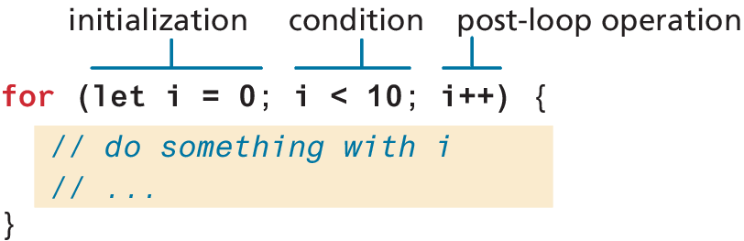
For Loops
For loops combine the common components of a loop—initialization, condition, and post-loop operation into one statement. This statement begins with the for keyword and has the components placed within () brackets, and separated by semicolons (;)
Source code: chapter04/03_loops

Slide 24

Try…catch
DIVE DEEPER
When the browser’s JavaScript engine encounters a runtime error, it will throw an exception. These exceptions interrupt the regular, sequential execution of the program and can stop the JavaScript engine altogether. However, you can optionally catch these errors (and thus prevent the disruption) using the try . . . catch block as shown below.
try {
nonexistantfunction("hello");
}
catch(err) {
alert ("An exception was caught:" + err);
}
try...catch can also be used to your own error messages.
Source code: chapter04/01_exceptions

Slide 25
Arrays
Arrays are one of the most commonly used data structures in programming.
JavaScript provides two main ways to define an array.
First approach is Array literal notation, which has the following syntax:
const name = [value1, value2, ... ];
The second approach is to use the Array() constructor:
const name = new Array(value1, value2, ... );

Slide 26
Array example
const years = [1855, 1648, 1420];
const countries = [“KSA", “Italy",
"Germany", "Nigeria",
“Vietnam", “Mali"];
// arrays can also be multi-dimensional ... notice the commas!
const twoWeeks = [
["Mon","Tue","Wed","Thu","Fri"],
["Mon","Tue","Wed","Thu","Fri"]
];
// JavaScript arrays can contain different data types
const mess = [53, "Canada", true, 1420];

Slide 27
Iterating an array using for . . . of
ES6 introduced an alternate way to iterate through an array, known as the for...of loop, which looks as follows.
// iterating through an array
for (let yr of years) {
console.log(yr);
}
//functionally equivalent to for (let i = 0; i < years.length; i++) {
let yr = years[i];
console.log(yr);
}
const countries = ["KSA", "Japan", "Oman"];
document.write('<table><tr><th>Country</th></tr>');
for ( let c of countries){
document.write('<tr><td>' + c + '</td><tr>')
}
document.write('</table>');

Slide 28
Array Destructuring
Let’s say you have the following array:
const league = ["Liverpool", "Man City", "Arsenal", "Chelsea"];
Now imagine that we want to extract the first three elements into their own variables. The “old-fashioned” way to do this would look like the following:
let first = league[0];
let second = league[1];
let third = league[2];
By using array destructuring, we can create the equivalent code in just a single line:
let [first,second,third] = league;

Slide 29
Objects
We have already encountered a few of the built-in objects in JavaScript, namely, arrays along with the Math, Date, and document objects.
In this section, we will learn how to create our own objects and examine some of the unique features of objects within JavaScript.
In JavaScript, objects are a collection of named values (which are called properties in JavaScript).
Unlike languages such as C++ or Java, objects in JavaScript are not created from classes. JavaScript is a prototype based language, in that new objects are created from already existing prototype objects.

Slide 30
Object Creation Using Object Literal Notation
The most common way is to use object literal notation (which we also saw earlier with arrays)
An object is represented by a list of key-value pairs with colons between the key and value, with commas separating key-value pairs.
To reference this object’s properties, we can use either dot notation or square bracket notation.
const objName = {
name1: value1,
name2: value2,
// ...
nameN: valueN
};
objName.name1
objName["name1"]
Source code: chapter04/02_objects/01_creation.js

Slide 31
Object Creation Using Object Constructor
Another way to create an instance of an object is to use the Object constructor, as shown in the following:
// first create an empty object
const objName = new Object();
// then define properties for this object
objName.name1 = value1;
objName.name2 = value2;
Generally speaking, object literal notation is preferred in JavaScript over the constructed form.

Slide 32
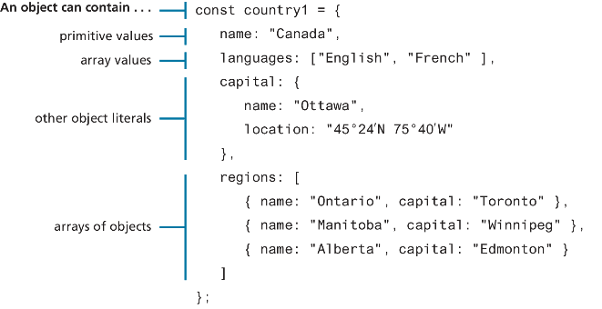
Objects containing other content

Slide 33
Exercise: (object creation)
Create an object that represents KSA, you have to include an id (the phone country code), the name, and an object that represents its currency. The currency is characterized by a name, a value against the dollar, a list of available coins and a list of available banknotes.
let ksa = {
id: ‘966',
name: 'KSA',
currency: {
name: 'riyal',
valueAgaintDollar: 0.2666,
coins: [ 0.01, 0.05, 0.1, 0.2, 0.5 ],
banknotes: [ 1, 5, 10, 20,
50, 100, 200, 500]
}
}

Slide 34
Object Destructuring
Just as arrays can be destructured, so too can objects.
Let’s use the following object literal definition.
const photo = {
id: 1,
title: "Central Library",
location: {
country: "Canada",
city: "Calgary"
}
};

Slide 35
Object Destructuring (ii)
You have to use the name of the property to access
One can extract out a given property using dot or bracket notation as follows.
let id = photo.id;
let title = photo["title"];
let country = photo.location.country;
let city = photo.location["city"];
Equivalent assignments using object destructuring syntax would be:
let { id, title } = photo;
let { country, city } = photo.location;
These two statements could be combined into one:
let { id, title, location: {country,city} } = photo;
Source code: chapter04/02_objects/03_object_destructuring.js

Slide 36
JSON
JavaScript Object Notation or JSON is used as a language-independent data interchange format analogous in use to XML.
The main difference between JSON and object literal notation is that property names are enclosed in quotes, as shown in the following example:
// this is just a string though it looks like an object literal
const text = '{ "name1" : "value1",
"name2" : "value2",
"name3" : "value3"
}’;
Try to access: https://mocki.io/v1/689a2e6a-39b0-4a2d-9f64-5baf8cf36571
Source code: chapter04/04_json/index.html

Slide 37
JSON object
The string literal on the last slide contains an object definition in JSON format (but is still just a string). To turn this string into an actual JavaScript object requires using the built-in JSON object.
// turn JSON string into an object
const anObj = JSON.parse(text);
// displays "value1“
console.log(anObj.name1);
const countries = ['{"id": "01", "name": "KSA"}',
'{"id": "02", "name": "Japan"}',
'{"id": "03", "name": "Oman"}'];
document.write('<table><tr><th>ID</th><th>Country</th></tr>');
for ( let c of countries){
let co = JSON.parse(c);
document.write('<tr><td>' + co.id + '</td><td>’
+ co.name + '</td><tr>')
}
document.write('</table>');
Source code: chapter04/04_json/index02.html

Slide 38
Functions
A function to calculate a subtotal as the price of a product multiplied by the quantity might be defined as follows:
function subtotal(price, quantity) {
return price * quantity;
}
The above is formally called a function declaration. Such a declared function can be called or invoked by using the () operator.
let result = subtotal(10,2);

Slide 39
Function expressions
// defines a function using an anonymous function expression
const calculateSubtotal = function (price,quantity) {
return price * quantity;
};
// invokes the function
let result = calculateSubtotal(10,2);
// define another function
const warn = function(msg) { alert(msg); };
// now invoke that function
warn("This doesn't return anything");

Slide 40
Default Parameters
In the following code, what will happen (i.e., what will bar be equal to)?
function foo(a,b) {
return a+b;
}
let bar = foo(3); // 3 + undefined -> NaN
The answer is NaN. However, there is a way to specify default parameters
function foo(a=10,b=0) { return a+b; }
Now bar in the above example will be equal to 3.

Slide 41
Rest Parameters
How to write a function that can take a variable number of parameters?
The solution is to use the rest operator (...)
The concatenate method takes an indeterminate number of string parameters separated by spaces.
function concatenate(...args) {
let s = "";
for (let a of args)
s += a + " ";
return s;
}
let girls = concatenate("fatima","hema","jane","alia");
let boys = concatenate("jamal","nasir");
console.log(girls); // "fatima hema jane alia“ console.log(boys); // "jamal nasir“
Example:
let sum = function ( ...args ) { let s = 0; for (let e of args ) s += e; return s}
Source code: chapter04/04b_functions/01_rest_parameters.html

Slide 42
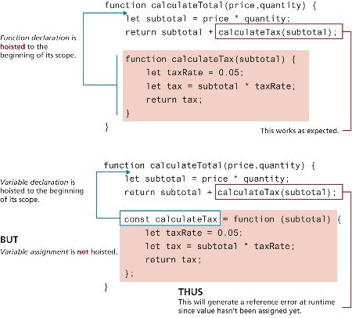
Hoisting in JavaScript
JavaScript function declarations are hoisted to the beginning of their current level
Hoisting is moving declarations to the top.
Note: the assignments are NOT hoisted.

Slide 43
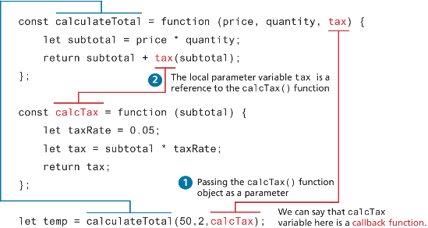
Callback Functions
Since JavaScript functions are full-fledged objects, you can pass a function as an argument to another function.
Callback function is simply a function that is passed to another function.
Example:
let sum = function( a ) { let s = 0; for (let e of a ) s += e; return s};
let map = function(f, ...args) { let s = [ ], i =0 ; for (let e of args ) s[i++] = f(e); return s};
map(sum, [3, 5, 6], [4, 7, 8], [8, 5])
Source code: chapter04/05_callback

Slide 44
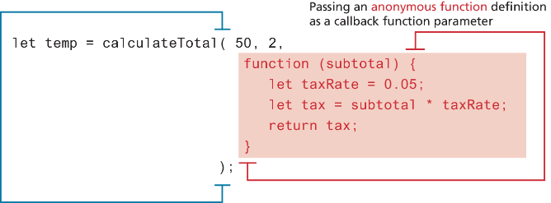
Callback Functions (ii)
We can actually define a function directly within the invocation

Slide 45
Objects and Functions Together
In a functional programming language like JavaScript, we say objects have properties that are functions. Note the use of the keyword this in the two functions
Note: Without the “this” keyword inside the “output” function, “brand” and “price” are not defined.
const order ={
salesDate : "May 5, 2016",
product : {
price: 500.00,
brand: "Acer",
output: function () { return this.brand + ' $' + this.price; }
},
customer : {
name: "Sue Smith",
address: "123 Somewhere St",
output: function () { return this.name + ', ' + this.address; }
}
};
alert(order.product.output());
alert(order.customer.output());

Slide 46
Constructors as functions
The following syntax creates a constructor (Customer).
Then we can create an object of that type using the new keyword.
We can call the output function on the created object.
// constructor as a function
function Customer(name, address, city) {
this.name = name;
this.address = address;
this.city = city;
this.output = function () {
return this.name + " " + this.address + " " + this.city;
};
}
// create instances of object using function constructor
const cust1 = new Customer("Sue", "123 Somewhere", "Calgary");
alert(cust1.output());
Source code: chapter04/06_constructor

Slide 47
Arrow Syntax (a, b) => {return a + b}
Arrow syntax provide a more concise syntax for the definition of anonymous functions.
const taxRate = function () { return 0.05; };
The arrow function version would look like the following:
const taxRate = () => 0.05;

Slide 48
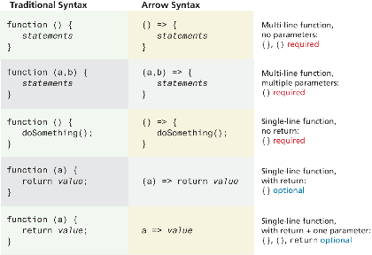
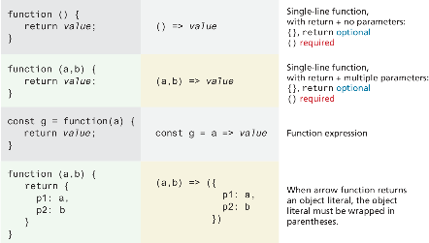
Array syntax overview

Slide 49
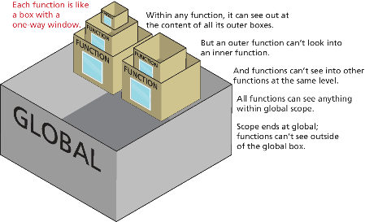
Scope in JavaScript
Scope generally refers to the context in which code is being executed.
JavaScript has four scopes:
function scope (also called local scope),
block scope,
module scope,
global scope.

Slide 50
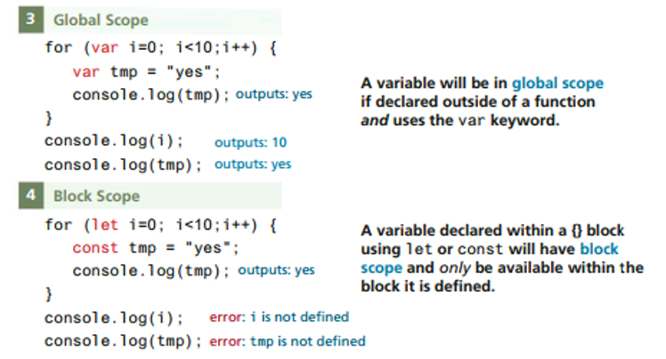
Block scope
Block-level scope means variables defined within an if {} block or a for {} loop block using the let or const keywords are only available within the block in which they are defined. But if declared with var within a block, then it will be available outside the block.

Slide 51
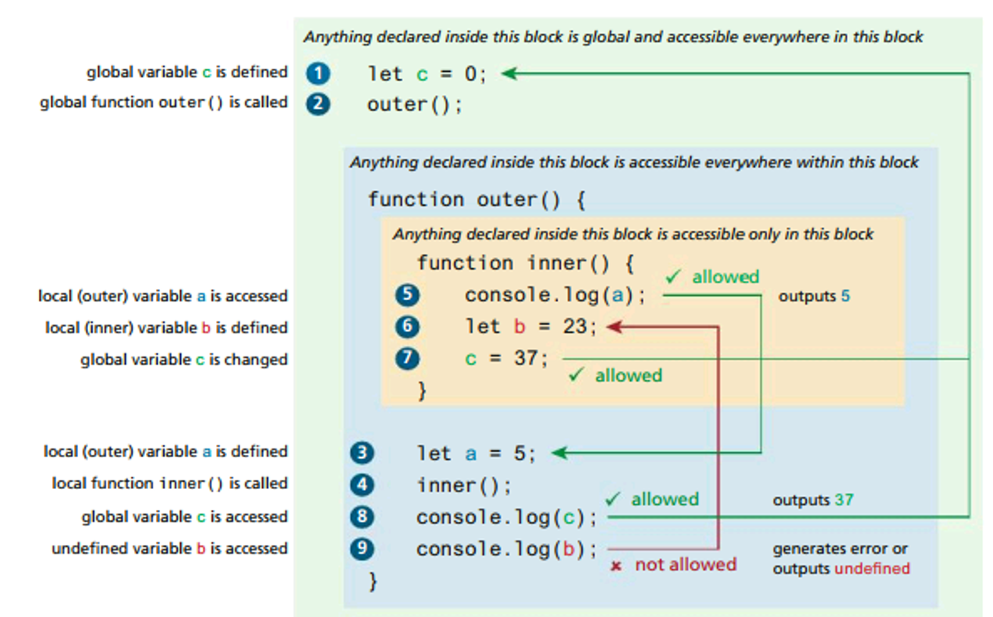
Function/Local Scope

Slide 52
Fundamentals of Web Development
Third Edition by Randy Connolly and Ricardo Hoar
JavaScript Part 2:
Using JavaScript in the front-end
Copyright © 2021, 2018, 2015 Pearson Education, Inc. All Rights Reserved

Slide 53
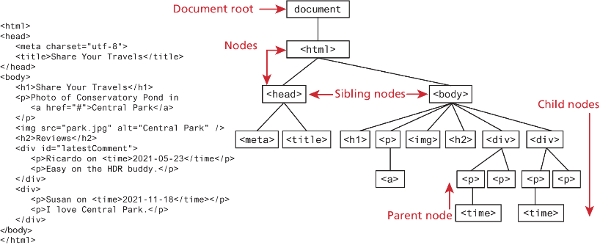
The Document Object Model (DOM)

Slide 54
Document Object
The DOM document object is the root JavaScript object representing the entire HTML document. It is globally accessible via the document object reference.
The properties of a document cover information about the page. Some are read-only, but others are modifiable. Like any JavaScript object, you can access its properties using either dot notation or square bracket notation
// retrieve the URL of the current page let a = document.URL; // retrieve the page encoding, for example ISO-8859-1 let b = document["inputEncoding"]; // equivalent to document.inputEncoding

Slide 55
DOM Nodes and NodeLists
In the DOM, each element within the HTML document is called a node.
The DOM also defines a specialized object called a NodeList that represents a collection of nodes. It operates very similarly to an array.
Many programming tasks that we typically perform in JavaScript involve finding one or more nodes and then modifying them.

Slide 56
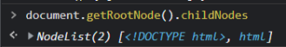
Some Essential Node Object Properties
childNodes A NodeList of child nodes for this node
firstChild First child node of this node
lastChild Last child of this node
nextSibling Next sibling node for this node
nodeName Name of the node
parentNode Parent node for this node
previousSibling Previous sibling node for this node
textContent Represents the text content (stripped of any tags) of the node

Slide 57
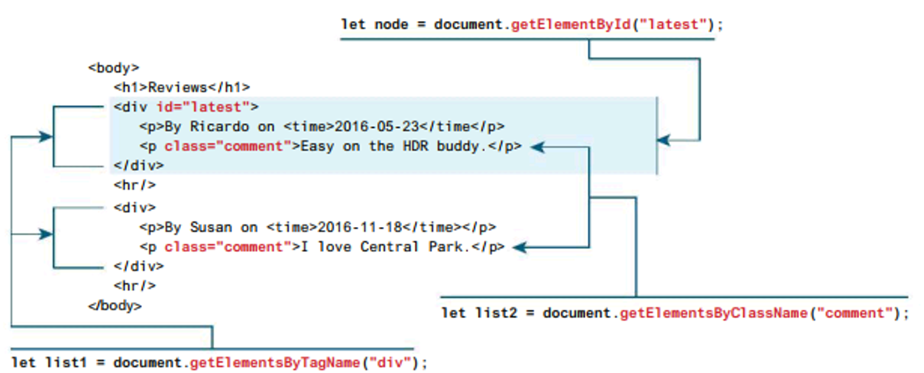
document object Methods: Selection
They allow you to select one or more document elements. The oldest 3 are: getElementById("id"), getElementsByClassName("name") and getElementsByTagName("name")

Slide 58
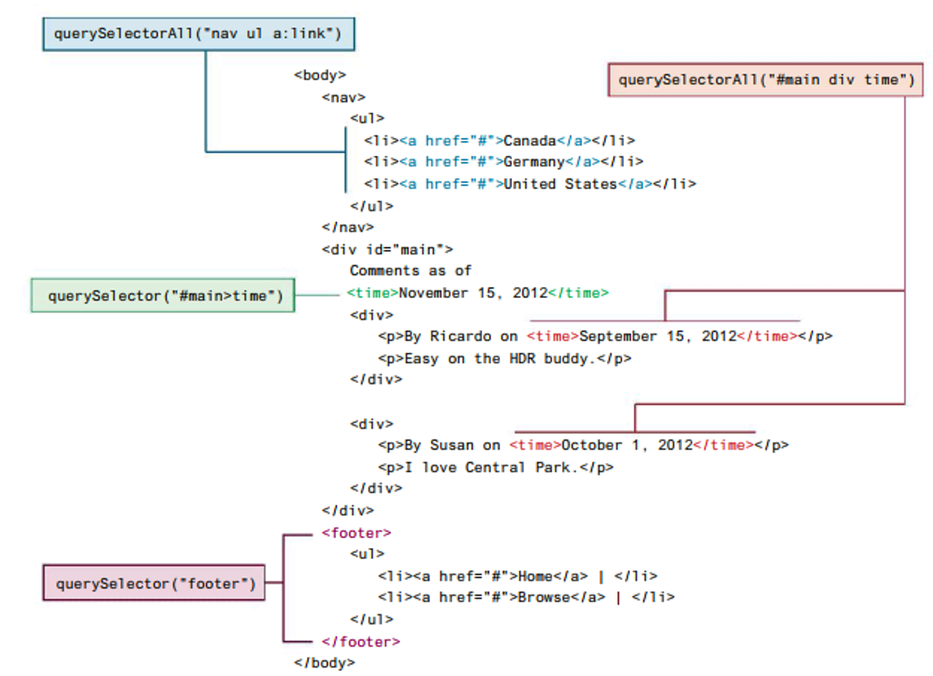
document object Methods: Query Selection
The newer querySelector() and querySelectorAll() methods allow you to query for DOM elements the same way you specify CSS styles
Notes:
Jquery Vs query selection : This stackOverFlow thread is very interesting to read (all answers are interesting but pay attention to the dates of the answers, newer answers are talking about the current state of both technologies):
https://stackoverflow.com/questions/11503534/jquery-vs-document-queryselectorall
Read especially this one:
“I transformed a div-tagcloud from jquery to native javascript (IE8+ compatible), the results are impressive. 4 (5.74 in reality) times faster with just a little overhead.
Number of lines Execution Time
Jquery version : 340 155ms
Native version : 370 27ms
“…..

Slide 59
Element Node Object
Element Node object represents an HTML element in the hierarchy, contained between the opening <> and closing </>.
Every Element Node has also these properties:
classList A read-only list of CSS classes assigned to this element. This list has a variety of helper methods for manipulating this list.
className The current value for the class attribute of this HTML element.
id The current value for the id of this element.
innerHTML Represents all the content (text and tags) of the element.
style The style attribute of an element. This returns a CSSStyleDeclaration object that contains sub-properties that correspond to the various CSS properties.
tagName The tag name for the element.

Slide 60
Extra Properties for Certain Tag Types
Property | Description | Tags
href | Used in <a> tags to specify the linking URL. | a
name | Used to identify a tag. Unlike id which is available to all tags, name is limited to certain form-related tags. | a, input, textarea, form
src | Links to an external URL that should be loaded into the page (as opposed to href which is a link to follow when clicked). | img, input, iframe, script
value | Provides access to the value attribute of input tags. Typically used to access the user’s input into a form field. | input, textarea, submit

Slide 61
Accessing elements and their properties
<p id="here">hello <span>there</span></p>
<ul>
<li>France</li>
<li>Spain</li>
<li>Thailand</li>
</ul>
<div id="main">
<a href="somewhere.html">
<img src="whatever.gif" class="thumb">
</a>
</div>
<script>
const node = document.getElementById("here");
console.log(node.innerHTML); // hello <span>there</span>
console.log(node.textContent); //“hello there”
const items = document.getElementsByTagName("li");
for (let i=0; i<items.length; i++) {
// outputs: France, then Spain, then Thailand
console.log(items[i].textContent);
}
const link = document.querySelector("#main a");
console.log(link.href); // outputs: somewhere.html
const img = document.querySelector("#main img");
console.log(img.src); // outputs: whatever.gif
console.log(img.className); // outputs: thumb
</script>
LISTING 9.1 Accessing elements and their properties
Source code: chapter04/08_dom

Slide 62
Changing an Element’s Style
To programmatically modify the styles associated with a particular element one must change the properties of the style property for that element
For instance, to change an element’s background color and add a three pixel border, we could use the following code:
const node = document.getElementById("someId");
node.style.backgroundColor = "#FFFF00";
node.style.borderWidth = "3px";
Notes:
for( let e of document.getElementsByTagName("div") ) { if(e.style) e.style.backgroundColor = "#456115"};

Slide 63
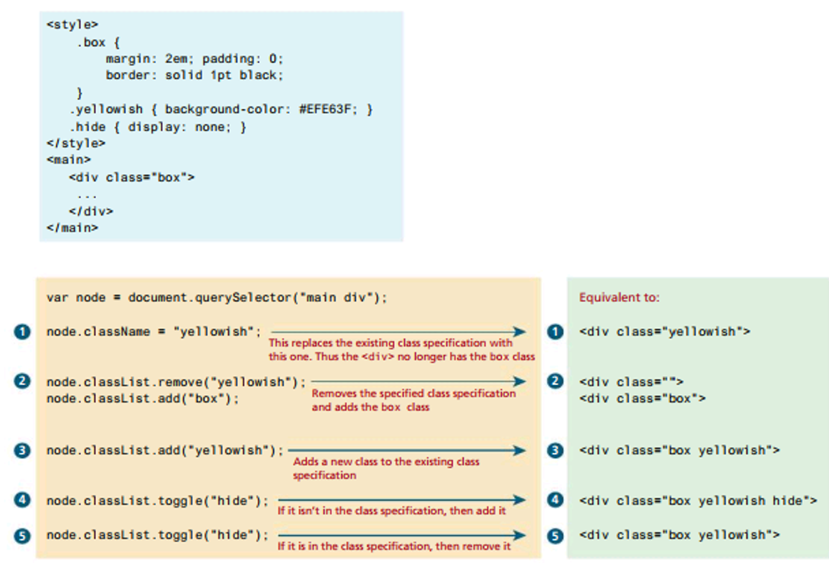
How CSS styles can be programmatically manipulated in JavaScript
While you can directly change CSS style elements via this style property, it is preferable to change the appearance of an element using the className or classList properties

Slide 64
InnerHTML vs textContent vs DOM Manipulation
You can programmatically access the content of an element node through its innerHTML or textContent property. These properties can also be used to modify the content of any given element.
For instance, you could change the content of the <div> using the following:
const div = document.querySelector("#main");
div.innerHTML = '<a href="#"><img src="ab.gif"></a>’;
This replaces the existing content with the new content. But, every time innerHTML is set, the HTML has to be parsed, a DOM constructed, and inserted into the document. This takes time.
Notes:
https://stackoverflow.com/questions/11515383/why-is-element-innerhtml-bad-code :
Every time innerHTML is set, the HTML has to be parsed, a DOM constructed, and inserted into the document. This takes time.
For example, if elm.innerHTML has thousands of divs, tables, lists, images, etc, then calling .innerHTML += ... is going to cause the parser to re-parse all that stuff over again. This could also break references to already constructed DOM elements and cause other chaos. In reality, all you want to do is append a single new element to the end.
It's better to just call appendChild
Security Risk:
Setting the value of innerHTML lets you replace the existing contents of an element with new content:
This is a security risk as the string to be inserted might contain potentially malicious content. When inserting user-supplied data you should always consider using Element.SetHTML() instead, in order to sanitize the content before it is inserted.

Slide 65
Exercise 2 (innerHTML + functions)
1- Write a function expression makeArticle that produces an HTML code that represents an article containing an h2 element and three p elements as follows:
Example:
makeArticle (“manager”, “Director”, “Salah”, “Abed”, salahabed@abc.com );
This call to the function should produce the HTML code displayed on the right inside into the node with the given id.
2- Rewrite this function as an arrow function
3- Create a constructor function for the Employee entity, add a function to its properties that returns the given HTML.
<div id=“manager”></div>
<div id=“manger”>
<article>
<h2>Position: Director</h2>
<p>Name: Salah</p>
<p>Last Name: Abed</p>
<p>Email: salahabed@abc.com</p>
</article>
</div>
Source code: chapter04/09_ex_innerhtml

Slide 66
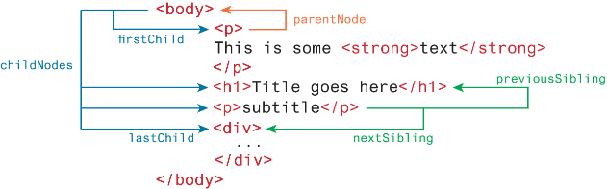
DOM family relations
Each node in the DOM has a variety of “family relations” properties and methods for navigating between elements and for adding or removing elements from the document hierarchy.
Child and sibling properties can be an unreliable mechanism for selecting nodes and thus, in general, you will instead use selector methods

Slide 67
DOM Manipulation Methods
appendChild Adds a new child node to the end of the current node.
createElement Creates an HTML element node.
createTextNode Creates a text node.
insertAdjacentElement Inserts a new child node at one of four positions relative to the current node.
insertAdjacentText Inserts a new text node at one of four positions relative to the current node.
removeChild Removes a child from the current node.
replaceChild Replaces a child node with a different child.
<!-- beforebegin -->
<p>
<!-- afterbegin -->
foo
<!-- beforeend -->
</p>
<!-- afterend -->

Slide 68
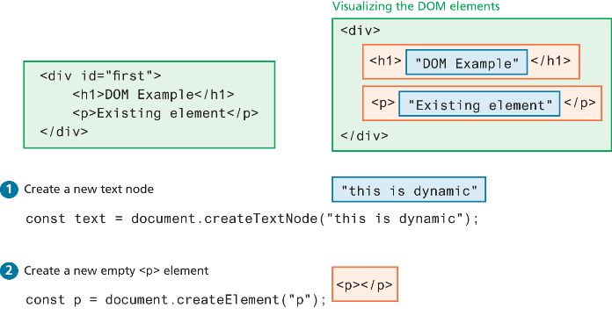
Visualizing the DOM modification
We want to add a new <p> to this <div>:

Slide 69
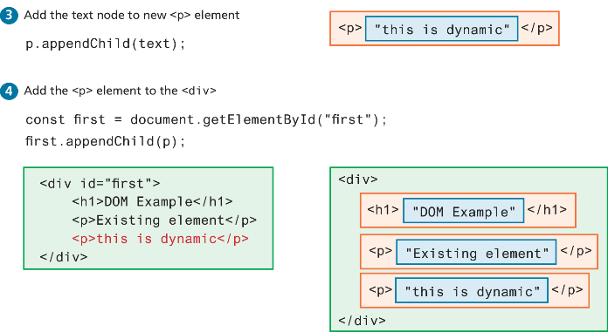
Visualizing the DOM modification (ii)

Slide 70
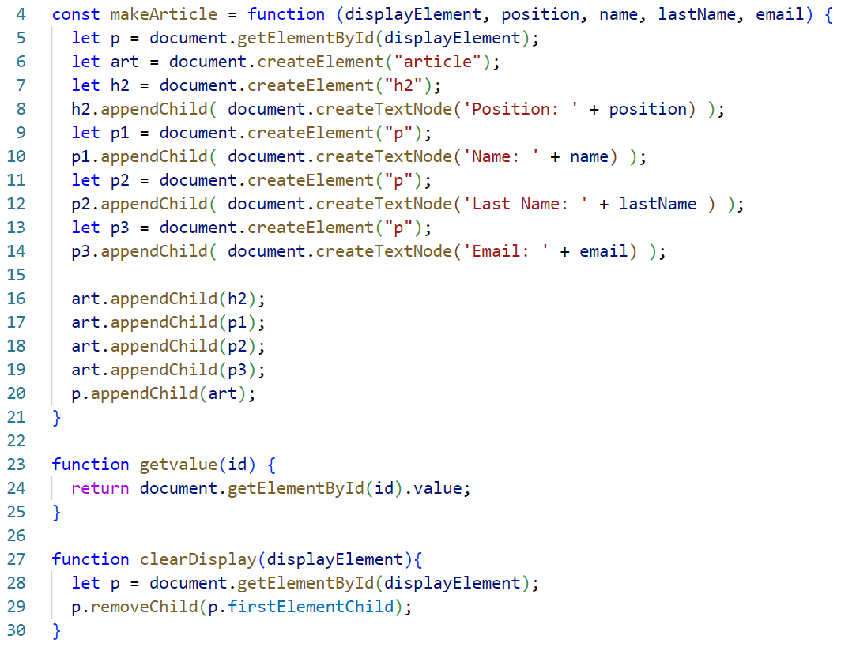
Same Exercise p65 (DOM manipulation)
Modify makeArticle to use DOM manipulation functions (createElement, appendChild, etc).
<article>
<h2>Position: Director</h2>
<p>Name: Salah</p>
<p>Last Name: Abed</p>
<p>Email: salahabed@abc.com</p>
</article>

Slide 71
DOM Timing
g2
g3
Before finishing this section on using the DOM, it should be emphasized that the timing of any DOM code is very important.
You cannot access or modify the DOM until it has been loaded.
If the DOM programming is written after the markup that should ensure that the elements exist in the DOM before the code executes.
To wait until we know for sure that the DOM has been loaded requires knowledge from our next section on event handling.

Slide 72
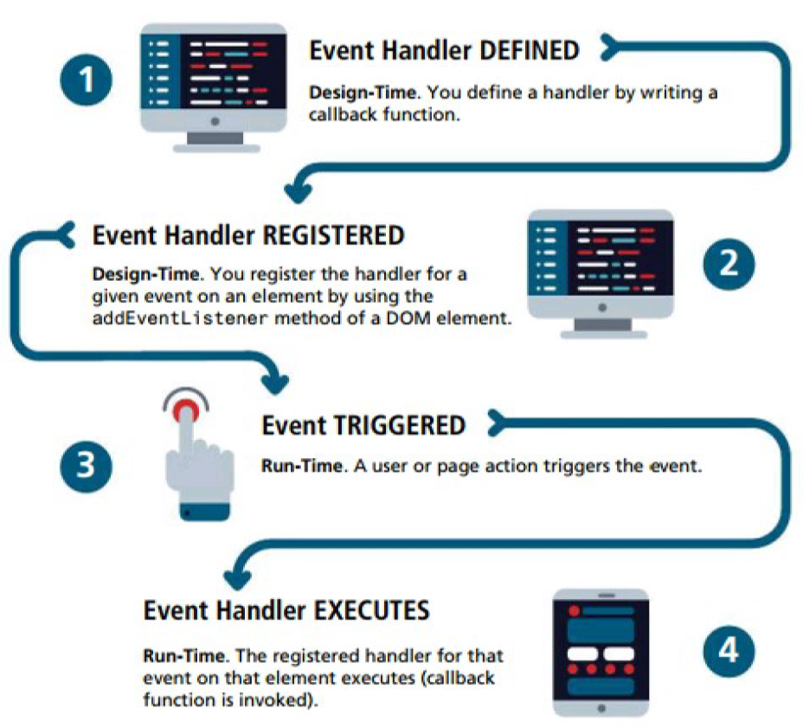
JavaScript Event Handling

Slide 73
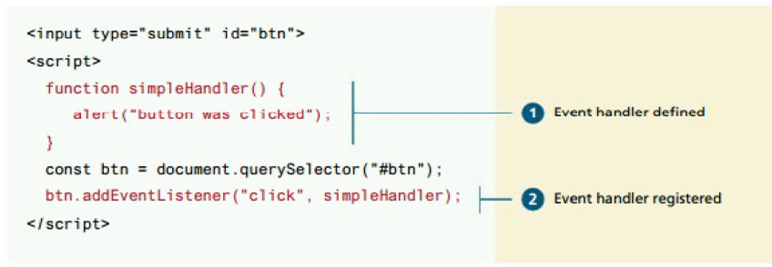
Implementing an Event Handler
An event handler is first defined, then registered to an element node object.
Registering an event handler requires passing a callback function to the addEventListener()

Slide 74
Handling events with anonymous functions
It is much more common to make use of an anonymous function passed to addEventListener()
const btn = document.getElementById("btn");
btn.addEventListener("click", function () {
alert("used an anonymous function");
});
document.querySelector("#btn").addEventListener("click", function (){
alert("a different approach but same result");
});
document.querySelector("#btn").addEventListener("click", () => {
alert("arrow syntax but same result");
});
LISTING 9.3 Listening to an event with an anonymous function, three versions

Slide 75
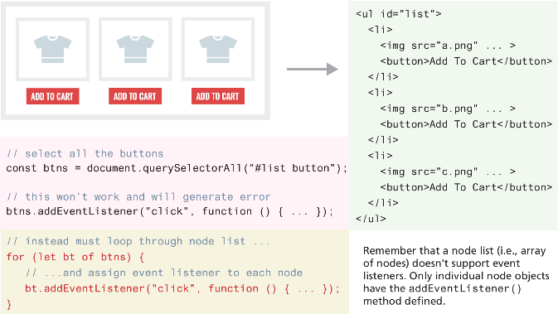
Event handling with NodeList arrays
g1
Source code: chapter04/12_events_window

Slide 76
Page Loading and the DOM
To ensure your DOM manipulation code executes after the page is loaded, use one of the following two different page load events.
window.load Fires when the entire page is loaded. This includes images and stylesheets, so on a slow connection or a page with a lot of images, the load event can take a long time to fire.
document.DOMContentLoaded Fires when the HTML document has been completely downloaded and parsed. Generally, this is the event you want to use.
Using one of these, your DOM coding can now appear anywhere, including within the <head> element as long as you do not try to access the DOM.
Source code: chapter04/13_events_DOM

Slide 77
Wrapping DOM code within a DOMContentLoaded event handler
document.addEventListener('DOMContentLoaded', function() {
const menu = document.querySelectorAll("#menu li");
for (let item of menu) {
item.addEventListener("click", function () {
item.classList.toggle('shadow’);
});
}
const heading = document.querySelector("h3");
heading.addEventListener('click', function() {
heading.classList.toggle('shadow’);
});
});

Slide 78
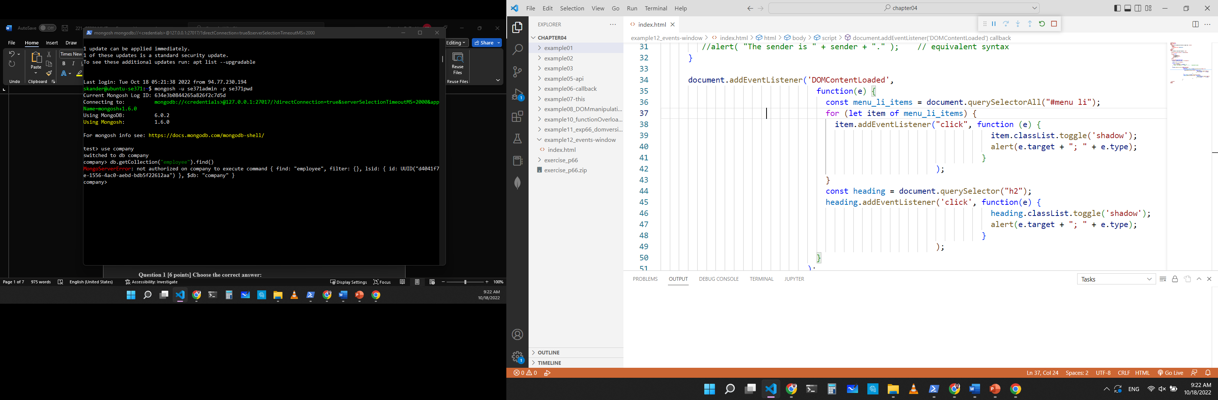
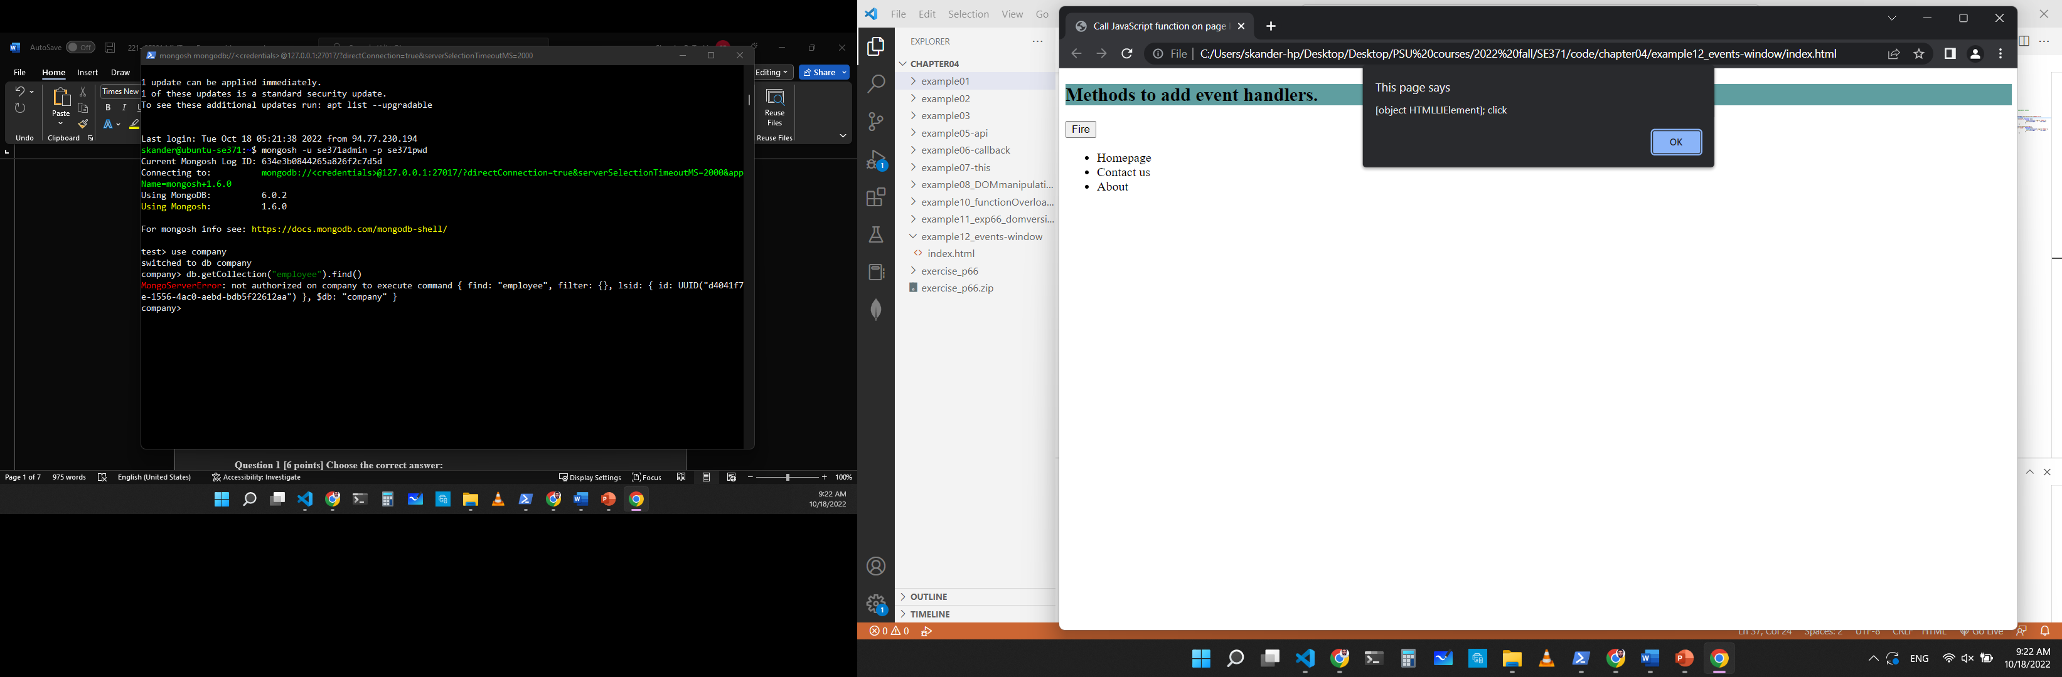
Event Object
When an event is triggered, the browser will construct an event object that contains information about the event.
Your event handlers can access this event object simply by including it as an argument to the callback function (this event object parameter is often named e)
Source code: chapter04/12_events_window

Slide 79
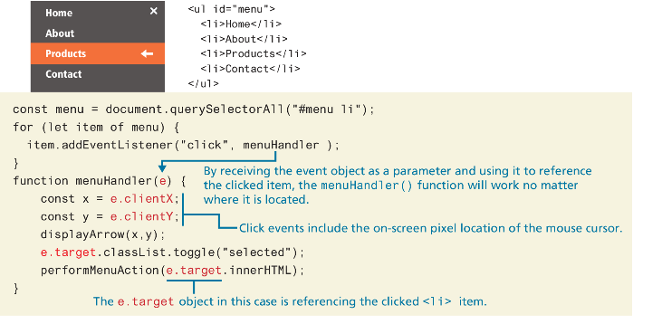
Event Object Example

Slide 80
Event Propagation
When an event fires on an element that has ancestor elements, the event propagates to those ancestors. There are two distinct phases of propagation:
In the event capturing phase, the browser checks the outermost ancestor (the <html> element) to see if that element has an event handler registered for the triggered event, and if so, it is executed (if configured to fire at this phase, see code example_18_event_propagation). It then proceeds to the next ancestor and performs the same steps; this continues until it reaches the element that triggered the event (that is, the event target).
In the event bubbling phase, the opposite occurs. The browser checks if the element that triggered the event has an event handler registered for that event, and if so, it is executed.

Slide 81
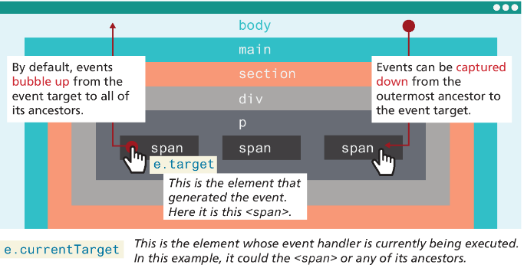
Event capture and bubbling

Slide 82
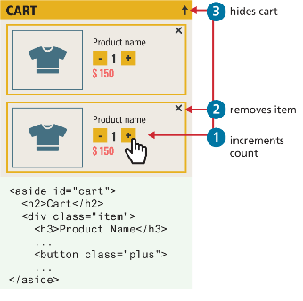
Problems with event propagation
Occasionally, the bubbling of events can cause problems. For instance consider elements nested within one another, each with its own on-click behaviors.
When the user clicks on the increment count button, the click handler for the increment <button> will trigger first. Unfortunately, it will then trigger the click event for the <div>, and the <aside> element!
Thankfully, there is a solution to such problems. The stopPropagation() method of the event argument object will stop event propagation.

Slide 83
Stopping event propagation
const btns = document.querySelectorAll(".plus");
for (let b of btns) {
b.addEventListener("click", function (e) {
e.stopPropagation();
incrementCount(e);
});
}
const items = document.querySelectorAll(".item");
for (let it of items) {
it.addEventListener("click", function (e) {
e.stopPropagation();
removeItemFromCart(e);
});
}
const aside = document.querySelector("aside#cart");
aside.addEventListener("click", function () {
minimizeCart();
});
LISTING 9.5 Stopping event propagation
Source code: chapter04/18_event_propagation

Slide 84
Event Delegation
To avoid creating duplicate event handlers for each element within a NodeList, an alternative is to use event delegation where we assign a single listener to the parent and make use of event bubbling
Suppose we have numerous image thumbnails within a parent element, similar to the following:
<body>
<header>...</header>
<main>
<section id="list">
<h2>Section Title</h2>
<img ... />
<img ... />
...
</section>
</main>
</body>

Slide 85
Event Delegation (ii)
Now what if you wanted to do something special when the user clicks the mouse on an <img>
You would probably write something like the following:
Notice that this solution adds an event listener to every <img> element.
const images = document.querySelectorAll("#list img");
for (let img of images) {
img.addEventListener("click", someHandler);
}

Slide 86
Event Delegation (iii)
Instead, we can add a single listener to the parent element, as shown in the following code
Since the user can click on any element within the <section> element, the click event handler needs to determine if the user has clicked on one of the <img> elements within it.
const parent = document.querySelector("#list");
parent.addEventListener("click", function (e) {
// e.target is the object that generated the event.
// to verify that e.target exists and that it is one of the
// <img> elements. Note: NodeName always returns
//upper case
if (e.target && e.target.nodeName == "IMG") {
doSomething(e.target);
}
});

Slide 87
Using the Dataset Property
G1 2 3
You can use the dataset property of DOM elements to store data, which provides read/write access to custom data attributes (data-*).
<div id="container" data-userid="2356" data-user-name="Salah">
<p id="display">The user ID is:</p>
</div>
<script>
const container = document.getElementById("container");
const user_id = container.dataset.userid;
const user_name = container.dataset.userName;
container.appendChild(document.createTextNode(`User info: ${user_id}, ${user_name}`)); </script>
Source code: chapter04/14_datasets

Slide 88
Event Types
There are many different types of events that can be triggered in the browser. Perhaps the most obvious event is the click event, but JavaScript and the DOM support several others.
mouse events,
keyboard events,
touch events,
form events, and
frame events.

Slide 89
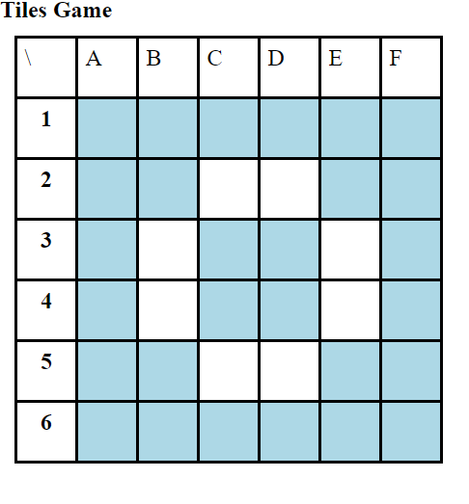
Mouse Events
click The mouse was clicked on an element.
dblclick The mouse was double clicked on an element.
mousedown The mouse pressed down over an element.
mouseup The mouse was released over an element.
mouseover The mouse was moved (not clicked) over an element.
mouseout The mouse was moved off of an element.
mousemove The mouse was moved while over an element.
Practice: Try to build a board game where the tiles are colored when a mouse event occurs.
Source code: chapter04/15_tiles_game

Slide 90
Keyboard Events
keydown The user is pressing a key (this happens first).
keyup The user releases a key that was down (this happens last).
document.getElementById("pagebody").addEventListener("keydown", function (e) {
// get the raw key code
let keyPressed=e.key;
// convert to string
let character=String.fromCharCode(keyPressed);
alert("Key " + character + " was pressed");
});

Slide 91
Form Events
blur Triggered when a form element has lost focus (i.e., control has moved to a different element), perhaps due to a click or Tab key press.
change Some <input>, <textarea>, or <select> field had their value changed. This could mean the user typed something or selected a new choice.
focus Complementing the blur event, this is triggered when an element gets focus (the user clicks in the field or tabs to it).
reset HTML forms have the ability to be reset. This event is triggered when that happens.
select When the user selects some text. This is often used to try and prevent copy/paste.
submit When the form is submitted this event is triggered. We can do some prevalidation of the form in JavaScript before sending the data on to the server.

Slide 92
Handling the submit event
document.querySelector("#loginForm").addEventListener("submit",
function(e) {
let pass = document.querySelector("#pw").value;
if (pass == "") {
alert ("enter a password");
e.preventDefault(); // prevents form submission
}
});
LISTING 9.8 Handling the submit event
Source code: chapter04/16_form_submit_event

Slide 93
Forms in JavaScript
JavaScript within forms is more than just the client-side validation of form data; JavaScript is also used to improve the user experience of the typical browser-based form.
As a result, when working with forms in JavaScript, we are typically interested in three types of events:
movement between elements,
data being changed within a form element, and
the final submission of the form.

Slide 94
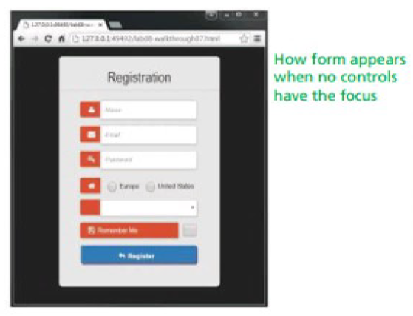
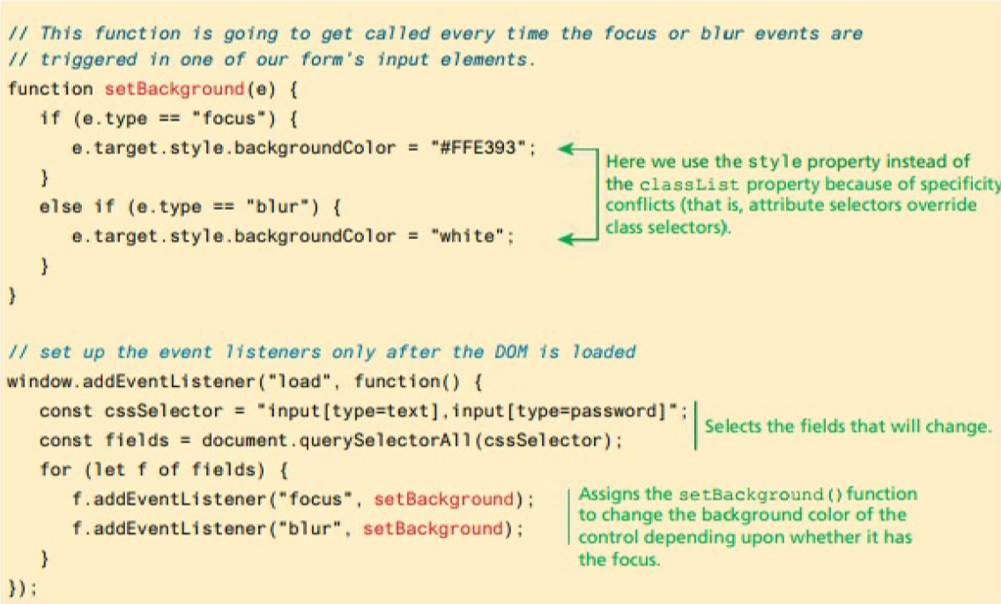
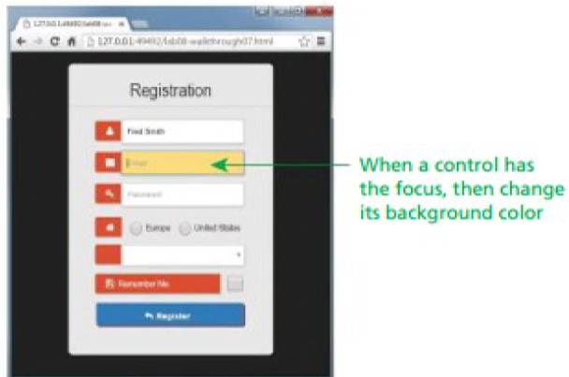
Responding to form movement events

Slide 95
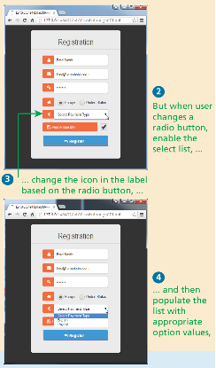
Responding to Form Changes Events
We may want to change the options available within a form based on earlier user entry. For instance, we may want the payment options to be different based on the value of the region radio button.
We can add event listeners to the change event of the radio buttons; when one of these buttons changes its value, then the callback function will set the available payment options based on the selected region.

Slide 96
Validating a Submitted Form
Form validation continues to be one of the most common applications of JavaScript.
Checking user inputs to ensure that they follow expected rules must happen on the server side for security reasons (in case JavaScript was circumvented); checking those same inputs on the client side using JavaScript will reduce server load and increase the perceived speed and responsiveness of the form.
Some of the more common validation activities include email validation, number validation, and data validation.
In practice, regular expressions are used to concisely implement many of these validation checks.

Slide 97
Empty Field Validation
const form = document.querySelector("#loginForm");
form.addEventListener("submit", (e) => {
const fieldValue = document.querySelector("#username").value;
if (fieldValue == null || fieldValue == "") {
// the field was empty. Stop form submission
e.preventDefault();
// Now tell the user something went wrong
console.log("you must enter a username");
}
});
LISTING 9.10 A simple validation script to check for empty fields

Slide 98
Determining which items in multiselect list are selected
const multi = document.querySelector("#listbox");
// using the options technique loops through each option and check if it is selected
for (let i=0; i < multi.options.length; i++) {
if (multi.options[i].selected) {
// this option was selected, do something with it ...
console.log(multi.options[i].textContent);
}
}
// the selectedOptions technique is simpler ... it only loops through the selected options
for (let i=0; i < multi.selectedOptions.length; i++) {
console.log(multi.selectedOptions[i].textContent);
}
LISTING 9.11 Determining which items in multiselect list are selected
Source code: chapter04/20_multiselect_validation

Slide 99
Javascript validation examples
Some browsers may not support HTML5 validation, in addition to the fact that we want to have more control over how we react to bad user input, it is always better to use javascript validation:
<form ….. > <input id="textA" type="number" max="100"> <button onclick="validateTextA()">Submit </button> <p id="output"></p> </form> | <script> function validateTextA() { var value = ""; if(document.getElementById("textA") .validity.rangeOverflow) { value = "The value must not be greater than 100"; } document.getElementById("output") .innerHTML = value; } </script>

Slide 100
Number Validation
Unfortunately, no simple functions exist for number validation. Using parseInt() or parseFloat(), isNAN(), and isFinite(), you can write your own number validation function.
Validating email, phone numbers, or social security numbers would include checking for blank fields and making use of isNumeric and regular expressions.
function isNumeric(n) {
return !isNaN(parseFloat(n)) && isFinite(n);
}
// you have to use both because 1/0 is considered a number
Notes:
The only difference is this:
!isNaN(1/0) // --> true
isFinite(1/0) // --> false

Slide 101
Submitting Forms using JS
To submit a form using JavaScript simply call the submit() method:
const formExample = document.getElementById("loginForm");
formExample.submit();
This is often done in conjunction with calling preventDefault() on the submit event.

Slide 102
Javascript validation examples (2)
Validating that two entered emails are the same: We can use onchange as it is triggered when we type enter or leave the field, so this is the right event handler to use.
<form> <label>Preferred email address: <input type="email" id="email_addr" name="email1" placeHolder="user@provider.domain" required></label> <label>Repeat email address: <input type="email" id="email_repeat" name="email2" required onchange="check()"></label> <input type = 'submit' value = "Send"> </form> | <script> function check() { var email1 = document.getElementById('email_addr'); var email2 = document.getElementById('email_repeat'); if ( email1.value !== email2.value) { alert("The two emails have to match"); } } </script>

Slide 103
Javascript validation examples (3)
The problem with the previous code is that we still can submit the form. So, we need to add a second check that blocks the submission of the Http request:
<form> <label>Preferred email address: <input type="email" id="email_addr" name="email1" placeHolder="user@provider.domain" required></label> <label>Repeat email address: <input type="email" id="email_repeat" name="email2" required onchange="return check()"></label> <input type = 'submit' value ="Send" onclick="return check();"> </form> | <script type="text/javascript"> function check() { var email1 = document.getElementById('email_addr'); var email2 = document.getElementById('email_repeat'); if ( email1.value != email2.value) { alert("The two emails have to match"); return false; } return true; } </script>

Slide 104
Regular Expressions
A regular expression is a set of special characters that define a pattern.
A regular expression consists of two types of characters: literals and metacharacters.
A literal is just a character you wish to match in the target (i.e., the text that you are searching within).
A metacharacter is a special symbol that acts as a command to the regular expression parser (there are 14, listed below).
. [ ] \ ( ) ^ $ | * ? { } +

Slide 105
Regular Expression Syntax (ii)
In JavaScript, regular expressions are case sensitive and contained within forward slashes. For instance
let pattern = /ran/;
will find matches in all three of the following strings:
'randy connolly'
'Sue ran to the store'
Note: The provided annex document gives more details about REGEX with javascript.
Examples: "crce".match(/[a-z]/g) , /[a-z]/i.test("vssdfs21321vsv")

Slide 106
Fundamentals of Web Development
Third Edition by Randy Connolly and Ricardo Hoar
JavaScript Part 3:
Additional Features
Copyright © 2021, 2018, 2015 Pearson Education, Inc. All Rights Reserved

Slide 107
Array Functions
forEach() iterate through an array
find() find the first object whose property matches some condition
filter() find all matches whose property matches some condition
map() is similar manner to filter except it creates a new array of the same size whose values have been transformed by the passed function
reduce() reduces an array into a single value
sort() sorts a one-dimensional array

Slide 108
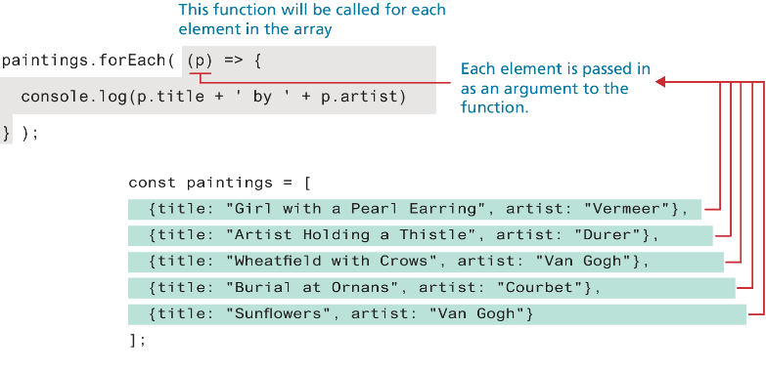
Array forEach()

Slide 109
Array find()
One of the more common coding scenarios with an array of objects is to find the first object whose property matches some condition. This can be achieved via the find() method of the array object, as shown below.
const courbet = paintings.find( p => p.artist === 'Courbet' );
console.log(courbet.title); // Burial at Ornans
Like the forEach() method, the find() method is passed a function; this function must return either true (if condition matches) or false (if condition does not match). In the example code above, it returns the results of the conditional check on the artist name.

Slide 110
Array filter(), and map()
If you were interested in finding all use the filter() method.
The map() function creates a new array of the same size but whose values have been transformed by the passed function.
const arr = ["hello", "selem", "ciao", "hallo", "gutentag"];
const pat = /el/;
pat.test(arr[0]) // will return true
pat.test(arr[2]) // will return false
arr.map(o => pat.test(o)) // [true, true, false, false, false]
arr.filter(o => pat.test(o)) // ['hello', 'selem']

Slide 111
Reduce
The reduce() function is used to reduce an array into a single value. Like the other array functions in this section, the reduce() function is passed a function that is invoked for each element in the array.
For instance, the following example illustrates how this function can be used to sum the value property of each painting object in our sample paintings array:
let initial = 0;
const total = paintings.reduce( (prev, p) => prev + p.value, initial);
Example 2:
const all = arr.reduce((prev, p) => prev+ " " + p) // 'hello selem ciao hallo gutentag'

Slide 112
Sort
sort() function sorts in ascending order (after converting to strings if necessary)
arr.sort() // ['ciao', 'gutentag', 'hallo', 'hello', 'selem’]
If you need to sort an array of objects based on one of the object properties, you will need to supply the sort() method with a compare function that returns either 0, 1, or −1, depending on whether two values are equal (0), the first value is greater than the second (1), or the first value is less than the second (−1).

Slide 113
Examples (reduce, sort array of objects)
let initial = 0;
const paintings = [
{title: "Girl with a pearl earring", artist: "Vermeer", value: 10},
{title: "Artists Holding a Thristle", artist: "Durer", value: 7},
{title: "Wheat field with Crows", artist: "Van Gogh", value: 16},
{title: "Burial at Ornans", artist: "Courbet", value: 18},
{title: "Wheat field with Crows", artist: "Van Gogh", value: 9}
];
//Compute sum of all these paintings values const total = paintings.reduce( (prev, p) => prev + p.value, initial );
console.log( total );
// sort the array based on the value property of painting objects const compareFn = (a, b) => a.value - b.value;
console.log( paintings.sort(compareFn));

Slide 114
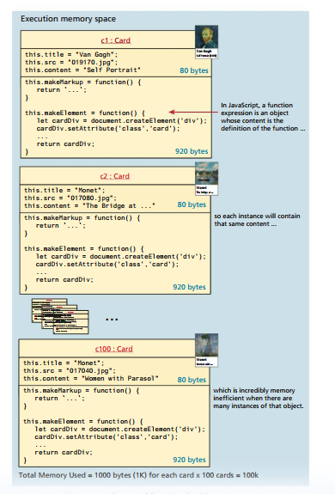
Prototypes, Classes
The example on the right shows what happens when you use constructor functions for creating multiple instances of objects. Notice how the function properties are also duplicated.
Constructor functions are therefore inefficient since memory must be allocated for each (identical) method.
Prototypes help address this issue.

Slide 115
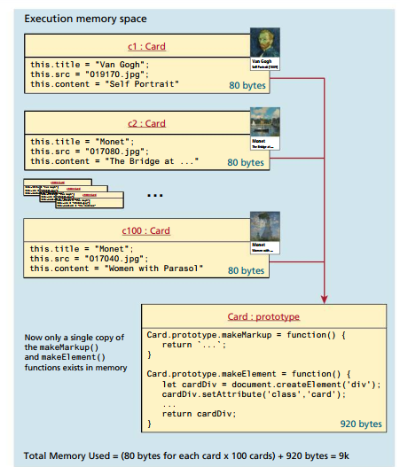
Prototypes
Prototypes make JavaScript behave more like an object-oriented language.
Every function object has a prototype property, which is initially an empty object.
The prototype properties are defined once for all instances of an object created with the new keyword from a constructor function.
This approach is far superior because it defines the method only once, no matter how many instances are created.

Slide 116
Using a prototype
function Card(title, src, content) {
this.title = title;
this.src = src;
this.content = content;
}
Card.prototype.makeMarkup = function() {
return `<div class="card">
<img src="${this.src}" alt="${this.title}" >
<div>
<h4>${this.title}</h4>
<p>${this.content}</p>
</div>
</div>`;
};
Card.prototype.makeElement = function() {
let cardDiv = document.createElement('div’);
….
cardDiv.appendChild(div);
return cardDiv;
};
// You use prototype functions as if they were declared in the object
const container = document.querySelector("#container");
const c1 = new Card("Van Gogh", "019170.jpg", "Self Portrait");
container.appendChild( c1.makeElement() );
LISTING 10.5 Using a prototype

Slide 117
Using Prototypes to Extend Other Objects
Prototypes also enable you to extend existing objects (including built-in objects) by adding to their prototypes. Imagine a method added to the String object that allows you to count instances of a character.
String.prototype.countChars = function (c) {
let count=0;
for (let i=0;i<this.length;i++) {
if (this.charAt(i) == c)
count++;
}
return count;
}
const msg = "HELLO WORLD";
console.log(msg + " has" + msg.countChars("L") + " letter L's");
LISTING 10.6 Extending a built-in object using the prototype

Slide 118
Classes
A class provides an alternate syntax for a function constructor and the extension of it via its prototype. In reality, they are merely “syntactical sugar” for JavaScript’s prototype approach
While the class syntax provides a familiar alternate syntax for working with functions, the developer community has not universally adopted it
Regardless of these concerns, the React framework, which has become one of the most widely adopted frameworks in the past several years uses JavaScript class syntax, so it is likely that as a JavaScript developer you will encounter this syntax more and more moving forward.

Slide 119
Using a class
class Card {
// constructor replaces the function constructor
constructor(title, src, content) {
this.title = title;
this.src = src;
this.content = content;
}
// class methods replace prototypes
makeMarkup() {
return `<div class="card">
<img src="${this.src}" alt="${this.title}" >
<div>
<h4>${this.title}</h4>
<p>${this.content}</p>
</div>
</div>`;
};
// notice the function property shorthand syntax
makeElement() {
let cardDiv = document.createElement('div’);
…
return cardDiv;
}
}
// Use the class
const container = document.querySelector("#container");
const c1 = new Card("Van Gogh", "images/019170.jpg", "Self Portrait");
container.append( c1.makeElement() );
LISTING 10.7 Implementing Listing 10.5 (slide 13) using class syntax

Slide 120
Extending classes and more
There are additional syntactical features of classes in JavaScript, including getters/ setters and static functions that we are not covering. Extending classes is one advanced feature worth noting. The extends keyword lets a class inherit the properties and methods of another class as with class-based programming languages such as Java or C#
class AnimatedCard extends Card {
constructor(title, src, content, effect) {
super(title, src, content)
this.effect=effect;
}

Slide 121

Reading…..
Read this book before graduation, when you finish it you’ll know why….

